Slide 1
Travel Grants
Upcoming call for Norwegian SMEs and related activities 2022-23
Artur Janusz
Entrepreneurship Support Department
Polish Agency of Enterprise Development

Slide 2


What a „Travel Grant” actually is?
Support scheme aimed at developing and strengthening cooperation among Polish and Norwegian SMEs through the organisation of trade missions.
Trade mission:
  one trade fair / congress (Annex 2), AND
  one bilateral event during the trade fair / congress, AND
  two meetings with at least two different entities operating in the territory of the country where the particular trade fair or conference/congress takes place.
Travel Grant structure:
  lump sum of € 1 800 per one trade mission to cover the cost of a business trip abroad,
  up to € 200 per one trade mission to cover the actual cost of admission tickets to the trade fair / congress.
Notes:
Travel Grants are provided for business trip abroad - to the Republic of Poland (Norwegian SMEs) in order to seek and establish bilateral contacts and identify promising mutual business opportunities to be developed in the future.
Support is provided for up to two trade missions for one applicant / SME. Each of these two missions of one applicant involves the attendance at the different trade fair / congress. The scope of each mission has to be related to at least one thematic areas of the Norway Grant Programme for Poland:
Green industry innovation – introducing innovations in technological solutions to SME’s to increase their competitiveness and value creation with less overall environmental impact.
Blue growth – particularly maritime or inland water sector, involving innovative processes and/or products for maritime and/or inland waters and coasts, including environmental improvement.
Welfare technologies – developing and launching products that facilitate functioning the everyday life of vulnerable social groups, such as the elderly.

Slide 3
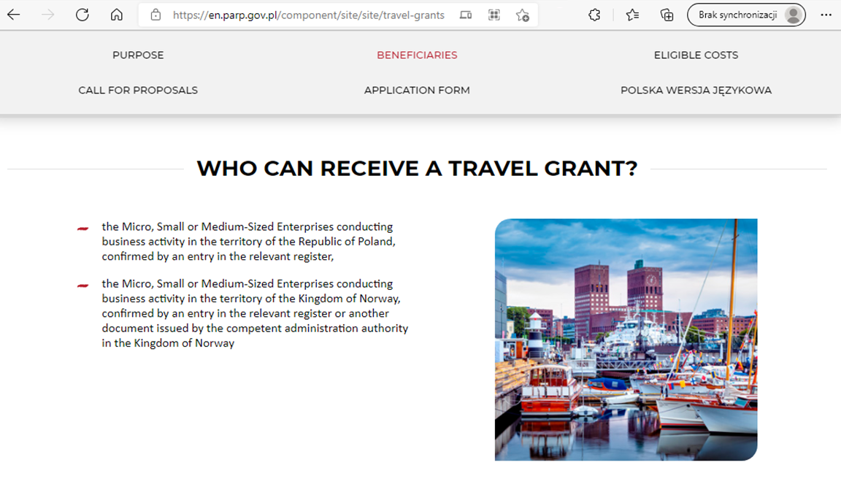

Applying for a Travel Grant
Please, check the website where the call documentation and the application form will be announced:
  https://en.parp.gov.pl/component/site/site/travel-grants
Notes:
Decide – 1 or 2 trade missions
Justify – pick at least one thematic area for each mission, explain your reasons & expected results for each tramission
Submit – we will e-mail you the copy of your application
Contract – prepare information and sign a TG contract with us
Take part – make your bookings and meet your partners and us during the chosen trade fairs and events
Settle TG – after completing your trade mission send us a report

Slide 4
Travel Grant-related bilateral events in 2022-23
Meet us at:
 | 2022 | 2023
POLAND trade missions of Norwegian SMEs | SALMED 2022 (24th March 2022, Poznan) POLECO 2022 (tbc, October 2022, Poznan) EUROPEAN CONGRESS of SMEs (tbc, 2022, Katowice) 590 CONGRESS (tbc, 2022, Jasionka/Rzeszow) | BALTEXPO 2023 (tbc, Autumn 2023, Gdansk)
NORWAY trade missions of Polish SMEs | NOR-SHIPPING 2022 (11th January 2022, Lillestrøm/Oslo) OSLO INNOVATION WEEK 2022 (tbc, Autumn 2022, Oslo)

Slide 5
Towards Sustainable Construction 2021
Matchmaking profiles of Polish attendees

Slide 6
Polish participants
2XS ARCHITECTURE | AMBERLINE | APA | ARTRYS PROJEKT | BALEX METAL
BIM ENGINEERS | BP DEVELOPMENT | BUDWOD | CONPEKA | CTS CHEMISTRY
DOMEK NA ROZTOCZU | ELGARD | GEOPROFIL | HIGH TECHNOLOGY GLASS | IZODOM 2000 POLSKA
JUMARPOL PRZEWIERTY | MIRPOL | MODU HALE | OKO.TRADE | POLISH CONNECTION
POLMAR / SMARTFLOW | PPMB NIEMCE | Q4SKI | SR INTERNATIONAL SERVICES | SUNROOF TECHNOLOGY
TERMEX-FIBER | TETON | THERMO PUMP | THE SHIRE CELLAR | VIKKING DOORS AND WINDOWS

